Slide 1
Adventure Works Cycle
Group : 3
Sanjana K Thacker
Anishmita Das
Satabdi Alok Mohakool
Sagar D Wanve
Manjiri M Duchakke
Nuhi Mohammed Salim Shaikh
Tejaswi Nilesh Khot

Slide 2




Introduction
Connecting & Shaping Data
Relational Data Model
Adding Calculated Fields
Visualizing Data with Reports

Slide 3
Overview Of Problem Statement
Sales Performance Analysis
Identify the best-selling products and their revenue contribution. Analyze sales trends across different regions and time periods. Assess the performance of sales representatives and channels.
Customer Segmentation
Identify customer demographics and purchasing behavior. Determine high-value customers and factors influencing their loyalty. Segment customers based on buying patterns.
Marketing Effectiveness
Evaluate the impact of marketing campaigns on sales. Identify the most effective promotional strategies. Optimize marketing spend for better ROI..
Financial Performance Analysis
Assess overall revenue, costs, and profitability. Detect anomalies and financial risks. Forecast future revenue trends.

Slide 4
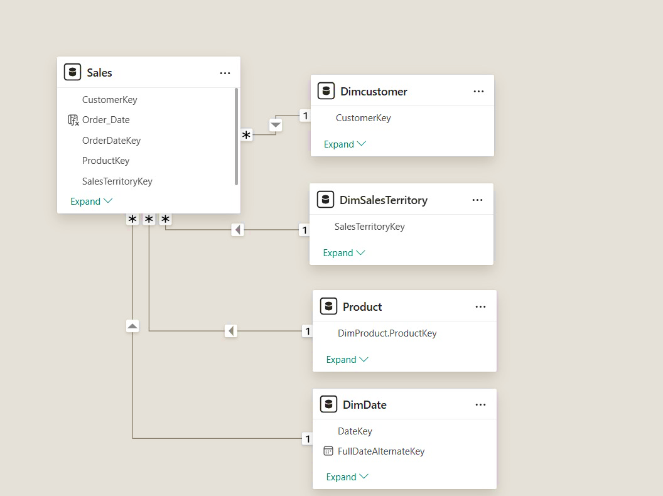
Data Modeling

Slide 5
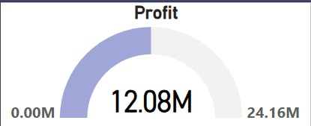
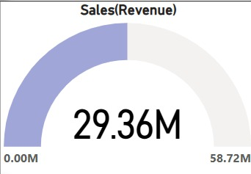
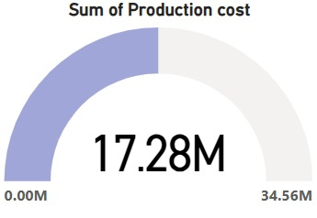
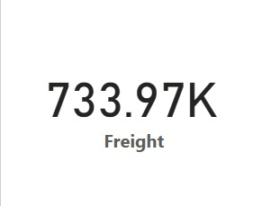
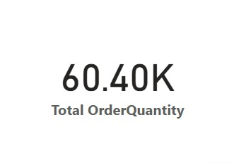
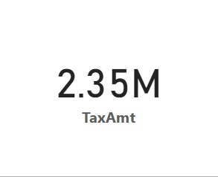
KPIs

Slide 6
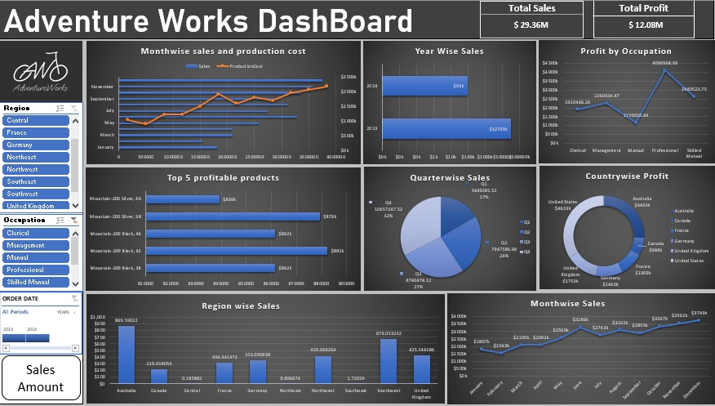
Excel Dashboard

Slide 7
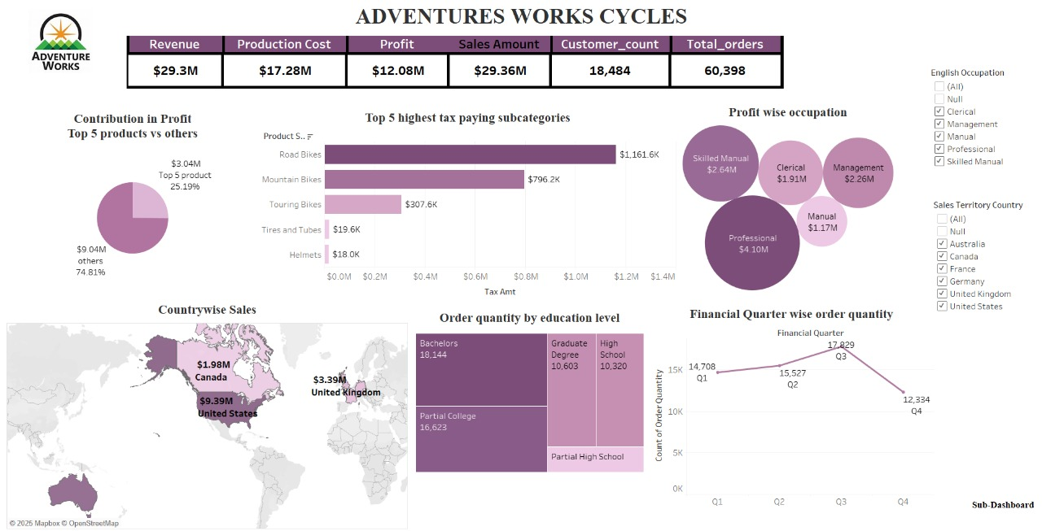
Tableau Dashboard

Slide 8
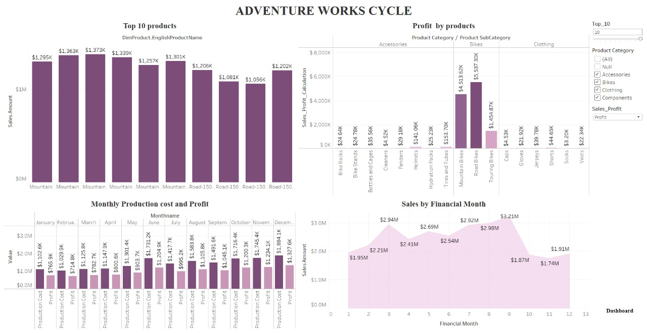
Tableau Sub-Dashboard

Slide 9
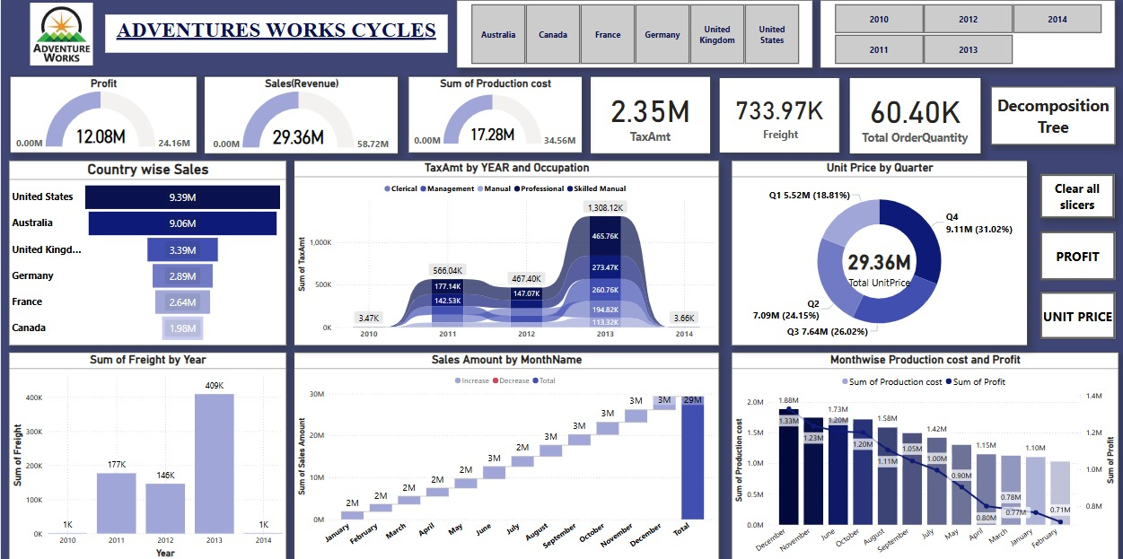
Power BI Dashboard

Slide 10
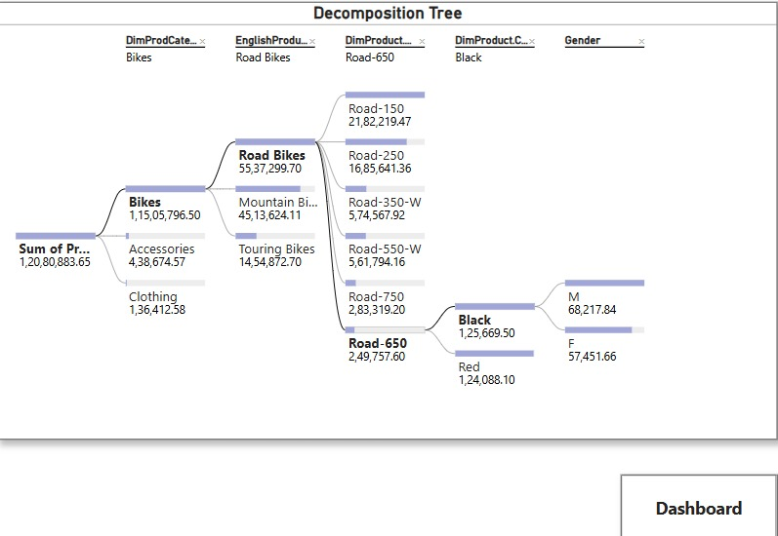
Decomposition Tree - PowerBI

Slide 11
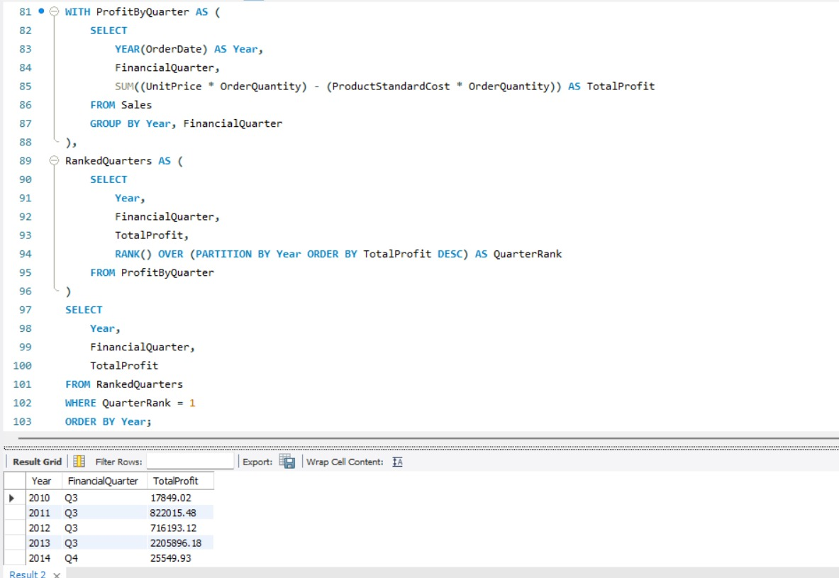
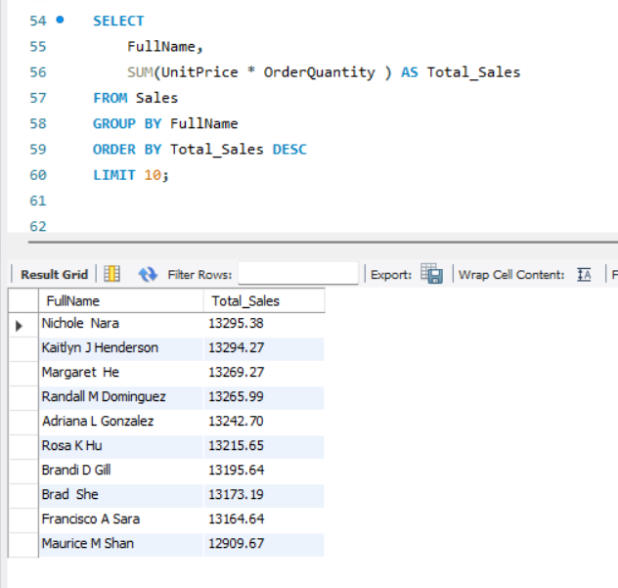
SQL
Yearly and Quarterly Profit
Top 10 Customers

Slide 12
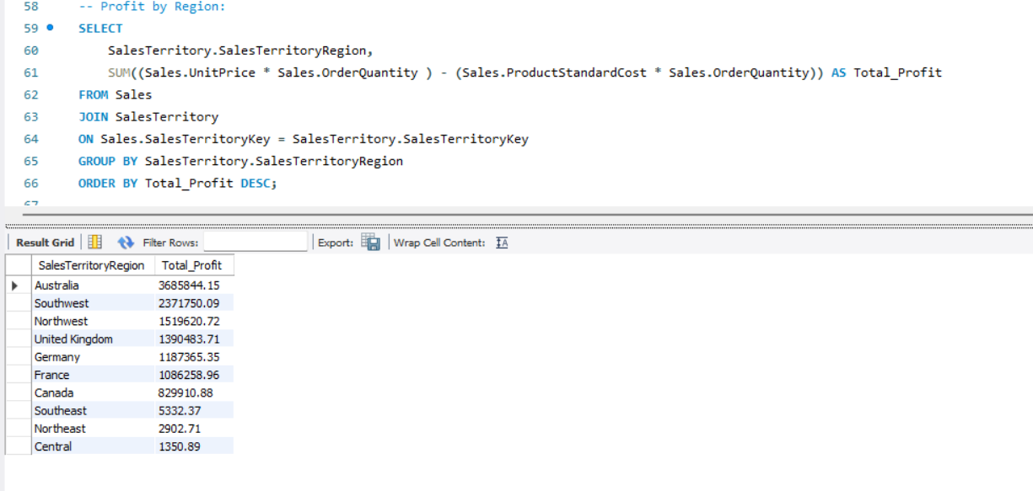
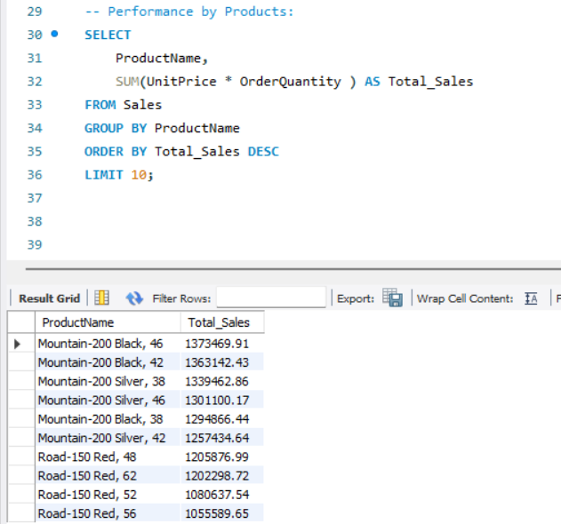
SQL
Region wise Profit
Top 10 Products

Slide 13
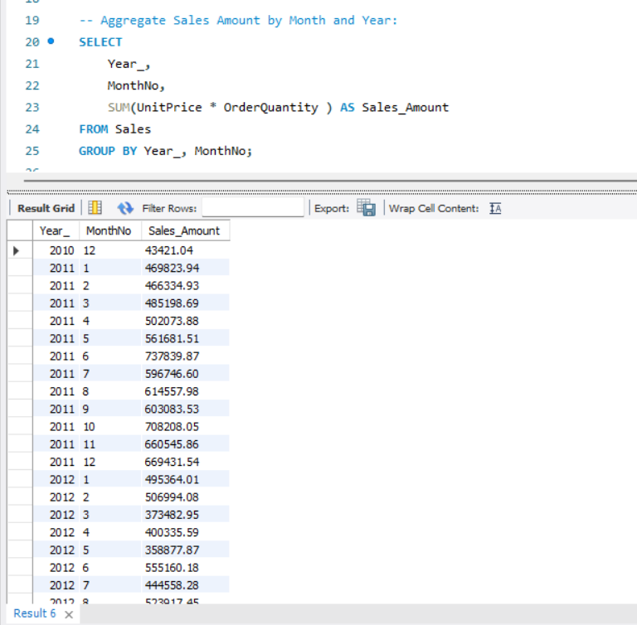
SQL
Monthly and Yearly Sales

Slide 14
Summary
Objective : The objective of this project was to analyze the sales data of a company and identify opportunities to broaden its market share by targeting its best customers, while also reducing the cost of sales through lower production costs.
Methodology :
Data Collection
Data Analysis
KPI Development
Key Findings :
Sales Performance
Customer Behaviour
Product Analysis
Financial Performance
Regional Performance
Marketing Effectiveness
Revenue Trends
Key Learnings :
Data-driven decision-making
KPI development:
Cost optimization
Sales growth strategies
Conclusion : This project demonstrated the importance of data-driven decision-making in driving business growth and optimizing costs. By analyzing sales data and developing KPIs, the company will able to identify opportunities to broaden its market share and reduce costs.

Slide 15
Challenges
Understanding the Database Structure
Writing Efficient SQL Queries
Data Quality Issues
Creating Useful Visualizations
Data Integration
Recommendations
Continue to monitor and analyze sales data to identify opportunities for growth and optimization
Develop and track additional KPIs to measure business performance and progress toward goals
Implement process improvements to reduce production costs and improve logistics and transportation management

Slide 16
Thank you

